Slide 1
Business Intelligence Concepts, Tools, and Applications
Week 4: Business Performance Management Systems
Lesson 4: Business Analytics

Slide 2
Business Analytics
Learning objectives
Define Visual Analytics and explain how it differs from information visualization.
Identify major categories and applications of business analytics (BA) and explain how various form of BA are supported in practice
Identify how the combination of BI and BA can result in competitive advantage for organizations

Slide 3
Business Analytics
Visual analytics is the combination of visualization and predictive analytics.
Information visualization is aimed at answering
“what happened” and “what is happening” and
is closely associated with business intelligence (routine reports, scorecards, and dashboards),
Predictive analytics is aimed at answering
“why is it happening,” “what is more likely to happen,” and
is usually associated with business analytics (forecasting, segmentation, correlation analysis).
From SHARDA, RAMESH; DELEN, DURSUN; TURBAN, EFRAIM, BUSINESS INTELLIGENCE AND ANALYTICS: SYSTEMS FOR DECISION SUPPORT, 10th Edition, © 2015. Used by permission of Pearson Education, Inc., New York, NY. All Rights Reserved.
Notes:
From SHARDA, RAMESH; DELEN, DURSUN; TURBAN, EFRAIM, BUSINESS INTELLIGENCE AND ANALYTICS: SYSTEMS FOR DECISION SUPPORT, 10th Edition, © 2015. Used by permission of Pearson Education, Inc., New York, NY. All Rights Reserved.

Slide 4
Business Analytics Overview
From SHARDA, RAMESH; DELEN, DURSUN; TURBAN, EFRAIM, BUSINESS INTELLIGENCE AND ANALYTICS: SYSTEMS FOR DECISION SUPPORT, 10th Edition, © 2015. Used by permission of Pearson Education, Inc., New York, NY. All Rights Reserved.
Notes:
From SHARDA, RAMESH; DELEN, DURSUN; TURBAN, EFRAIM, BUSINESS INTELLIGENCE AND ANALYTICS: SYSTEMS FOR DECISION SUPPORT, 10th Edition, © 2015. Used by permission of Pearson Education, Inc., New York, NY. All Rights Reserved.

Slide 5
Descriptive Analytics
Descriptive or reporting analytics refers to
knowing what is happening in the organization
understanding some underlying trends and causes of such occurrences
It involves
consolidation of data sources and availability of all relevant data in a form that enables appropriate reporting and analysis.
usually development of this data infrastructure is part of data warehouses
From SHARDA, RAMESH; DELEN, DURSUN; TURBAN, EFRAIM, BUSINESS INTELLIGENCE AND ANALYTICS: SYSTEMS FOR DECISION SUPPORT, 10th Edition, © 2015. Used by permission of Pearson Education, Inc., New York, NY. All Rights Reserved.
Notes:
From SHARDA, RAMESH; DELEN, DURSUN; TURBAN, EFRAIM, BUSINESS INTELLIGENCE AND ANALYTICS: SYSTEMS FOR DECISION SUPPORT, 10th Edition, © 2015. Used by permission of Pearson Education, Inc., New York, NY. All Rights Reserved.

Slide 6
Predictive Analytics
Predictive analytics aims to determine what is likely to happen in the future.
Uses statistical and data mining techniques to predict if the customer is likely to
switch to a competitor (“churn”),
buy next and how much,
respond to promotion,
worth the risk
From SHARDA, RAMESH; DELEN, DURSUN; TURBAN, EFRAIM, BUSINESS INTELLIGENCE AND ANALYTICS: SYSTEMS FOR DECISION SUPPORT, 10th Edition, © 2015. Used by permission of Pearson Education, Inc., New York, NY. All Rights Reserved.
Notes:
From SHARDA, RAMESH; DELEN, DURSUN; TURBAN, EFRAIM, BUSINESS INTELLIGENCE AND ANALYTICS: SYSTEMS FOR DECISION SUPPORT, 10th Edition, © 2015. Used by permission of Pearson Education, Inc., New York, NY. All Rights Reserved.

Slide 7
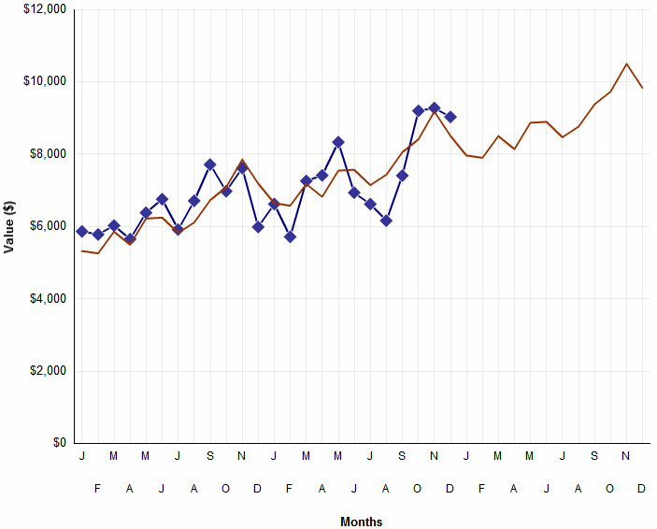
Bring Predictive Analysis into the Mainstream for Business Users
Typical Predictive Analyses
Based on Regression Techniques
Powerful Predictive Analyses
Based on Data Mining Techniques
Sales Forecast Area
Achieve Revenue
Stay in Budget
Respond
Purchase
Defraud
Be Profitable
Be On Time
DETERMINE
WHO IS
LIKELY TO …
Linear Regression
Logistic Regression
Tree Regression
Decision Tree
Clustering
Time Series
Association Rules
Neural Network
Rule Set
Support Vector Machines
Ensembles of Models
Notes:
Analytics is the sophisticated analysis and use of business data to enable fact-based decision making at every level of your organization.
Analytics can drive superior performance – from customer management to the supply chain to product/service development to strategic planning.
For top companies such as Marriott International, Harrah’s Entertainment, Capital One, Amazon.com, Netflix and the Boston Red Sox, analytics creates a competitive advantage.
Quick examples:
Amazon uses market basket analysis
Mars uses linear regression to predict candy sales, particularly during peak holidays like Halloween

Slide 8
Prescriptive Analytics
Prescriptive analytics aim to recognize
what is going on,
the likely forecast, and
the best performance possible using optimization techniques
From SHARDA, RAMESH; DELEN, DURSUN; TURBAN, EFRAIM, BUSINESS INTELLIGENCE AND ANALYTICS: SYSTEMS FOR DECISION SUPPORT, 10th Edition, © 2015. Used by permission of Pearson Education, Inc., New York, NY. All Rights Reserved.
Notes:
From SHARDA, RAMESH; DELEN, DURSUN; TURBAN, EFRAIM, BUSINESS INTELLIGENCE AND ANALYTICS: SYSTEMS FOR DECISION SUPPORT, 10th Edition, © 2015. Used by permission of Pearson Education, Inc., New York, NY. All Rights Reserved.

Slide 9
Big Data Analytics
Big Data? It refers to data that
cannot be stored in a single storage unit
is arriving in many different forms, be they structured, unstructured, or in a stream
are clickstreams from Web sites, postings on social media sites such as Facebook, or data from traffic, sensors, or weather
Big Data analytics solution
instead of pushing data to a computing node, solution pushes computation to the data
From SHARDA, RAMESH; DELEN, DURSUN; TURBAN, EFRAIM, BUSINESS INTELLIGENCE AND ANALYTICS: SYSTEMS FOR DECISION SUPPORT, 10th Edition, © 2015. Used by permission of Pearson Education, Inc., New York, NY. All Rights Reserved.
Notes:
From SHARDA, RAMESH; DELEN, DURSUN; TURBAN, EFRAIM, BUSINESS INTELLIGENCE AND ANALYTICS: SYSTEMS FOR DECISION SUPPORT, 10th Edition, © 2015. Used by permission of Pearson Education, Inc., New York, NY. All Rights Reserved.

Slide 10
Business and Visual Analytics Platforms
More BI and analytics vendors are becoming aware that their customers require quick and preferably interactive visualizations, not just for their normal reporting systems, but also to illustrate predictive and prescriptive decision-making information.
A high-powered visualization environment is one in which high-performance, in-memory solutions are applied to exploring massive amounts of data instantaneously.
Due to the increasing demand for visual analytics coupled with fast-growing data volumes, there is an ever-growing need to invest in highly efficient Visual Analytics Platforms.
MicroStrategy Visual Insight and SAS Visual Analytics are examples of such platforms.
From SHARDA, RAMESH; DELEN, DURSUN; TURBAN, EFRAIM, BUSINESS INTELLIGENCE AND ANALYTICS: SYSTEMS FOR DECISION SUPPORT, 10th Edition, © 2015. Used by permission of Pearson Education, Inc., New York, NY. All Rights Reserved.
Notes:
From SHARDA, RAMESH; DELEN, DURSUN; TURBAN, EFRAIM, BUSINESS INTELLIGENCE AND ANALYTICS: SYSTEMS FOR DECISION SUPPORT, 10th Edition, © 2015. Used by permission of Pearson Education, Inc., New York, NY. All Rights Reserved.

Slide 11
Companies Are Using BI and BA based Strategies To Achieve Business Excellence
Optimization
Predictive Modeling
Forecasting/extrapolation
Statistical analysis
What’s the best that can happen?
What will happen next?
What if these trends continue?
Why is this happening?
Competitive Advantage
Alerts
Query/drill down
Ad hoc reports
Standard reports
What actions are needed?
Where exactly is the problem?
How many, how often, where?
What happened?
Sophistication of Intelligence
Competing on Analytics: The New Science of Winning, by Thomas H. Davenport and Jeanne G. Harris (Harvard Business School Press, March 2007).
Notes:
From Competing on Analytics: The New Science of Winning, by Thomas H. Davenport and Jeanne G. Harris (Harvard Business School Press, March 2007).

Slide 12
Organizations Are Building Their Competitive Strategies Around Analytics
Analytic competitors are found in a variety of industries
Stage 5: Analytical Competitors
Entertainment
New England Patriots, Harrah’s, Oakland A’s, Marriott
eCommerce
Google, Netflix,
Yahoo!
Industrial Products
John Deere, CEMEX
Stage 4: Analytical Companies
Retail
Amazon.com, Wal-Mart
Consumer Products
Anheuser-Busch, E&J Gallo Winery, P&G, Mars
Stage 3: Analytical Aspirations
Telecoms
Sprint, O2, Bouygues Telecom
Financial Services
Barclays Bank,
Capital One,
Progressive Insurance, WellPoint
Stage 2: Localized Analytics
Pharmaceuticals
AstraZeneca, Solvay, Vertex
Stage 1: Analytically Impaired
Transport
FedEx, Schneider National, United Parcel Service
Competing on Analytics: The New Science of Winning, by Thomas H. Davenport and Jeanne G. Harris (Harvard Business School Press, March 2007).
Notes:
From Competing on Analytics: The New Science of Winning, by Thomas H. Davenport and Jeanne G. Harris (Harvard Business School Press, March 2007).

